Slide 1
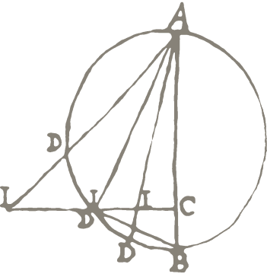

16 Jun · London · Pascal Belouin & Sean Wang
RISE and SHINE:
An API-based Infrastructure for Multilingual Textual Resources
Max Planck Institute for the History of Science
Notes:
ADD THE RISE LOGO HERE SOMEWHERE

Slide 2
DH research based on multilingual texts
There are many digital multilingual texts!
Many non-English texts have been digitized!
Many databases offer texts in various formats
How do we allow easy access to these multilingual texts?
Many exciting digital tools are now available
Scholars need to provide texts into these tools
How can we make this resources-to-tools workflow as seamless as possible?
Notes:
Sources:
Historians pull primary and secondary sources from a variety of sources in a variety of formats: insist on the heterogenous nature of the sources, as well as the fact that some are open access while others are licensed.
Digital Tools:
While sources and tools are already digital, historians cannot simply combine them for research for various reasons.

Slide 3
RISE & SHINE is a digital infrastructure that links resources and tools
SHINE: An API-based data exchange format allowing the secure machine-to-machine exchange of (licensed and open-access) resources in any language
RISE: A secure and trust-worthy guard in between every transfer to make sure that every exchange is authorized
https://rise.mpiwg-berlin.mpg.de/
Notes:
•Solution: RISE allows researchers to access resources, and to use research tools to work on them, from multiple providers through protected APIs or a browser interface. RISE implements a Policy Decision Point (PDP) to regulate and keep track of interactions between research tools and resources to ensure licensing compliance.
instead of creating multiple giant silos in the web, we follow a design that is very distributed network etc. via protected APIs.
authentication is important for licensed materials… then every resource providers could be connected to any research tools.
A common API (a language that everyone talks) for transferring texts between databases and tools => SHINE
A secure and trust-worthy guard in between every transfer to make sure a text is transferred to an authenticated user from an authorized institute => RISE

Slide 4
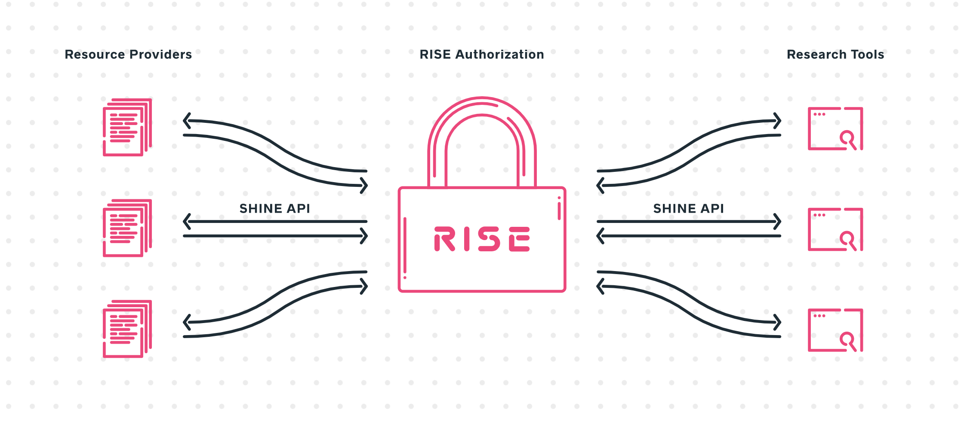
Notes:
Important to note that RISE is not a platform! No re-creating silos of databases or duplicating efforts to design brand-new tools. Distributing various types of resources in a unified and generic way to a variety of tools using machine-to-machine communication.

Slide 5
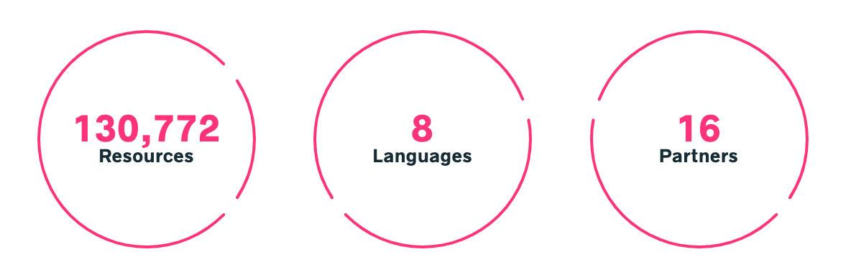
Notes:
Important to note that RISE is not a platform! No re-creating silos of databases or duplicating efforts to design brand-new tools. Distributing various types of resources in a unified and generic way to a variety of tools using machine-to-machine communication.

Slide 6
Current Partners: Resource Providers
Chinese Buddhist Electronic Text Association (Jen-Jou “Joey” Hung)
Chinese Text Project (Donald Sturgeon)
Corpus-DB (Jonathan Reeve)
Freie Universität Berlin (Beatrice Gründler, Mahmoud Kozae)
Harvard-Yenching Library (James K.M. Cheng, Sharon Li-Shiuan Yang)
Kanseki Repository (Christian Wittern)
National Taiwan University (Jieh Hsiang)
Staatsbibliothek zu Berlin (Matthias Kaun, Martina Siebert, Hou Ieong “Brent” Ho)
Esukhia (Elie Roux)

Slide 7
Research Tools
Current:
Recogito (Pelagios Commons: Rainer Simon, Rebecca Kahn)
Upcoming:
MARKUS & COMPARATIVUS (Leiden University: Hilde De Weerdt, Hou Ieong “Brent” Ho)
Docusky (National Taiwan University Digital Humanities Research Center: Xiang Jie, Du Xiechang)

Slide 8
Facilitating RISE & SHINE’s adoption through open-source software development
For research tool developers:
RISE Javascript library, React.js and Vue.js toolkits, Python SHINE script
For resource owners and providers:
Open-source RISE Resource-provider software reference implementation
Upcoming: Integration with Github and other types of resource repositories

Slide 9
Demo:
How RISE & SHINE enabled seamless import of multilingual resources into Recogito
(https://recogito.pelagios.org/)
Notes:
We are faced with two challenges:

Slide 10
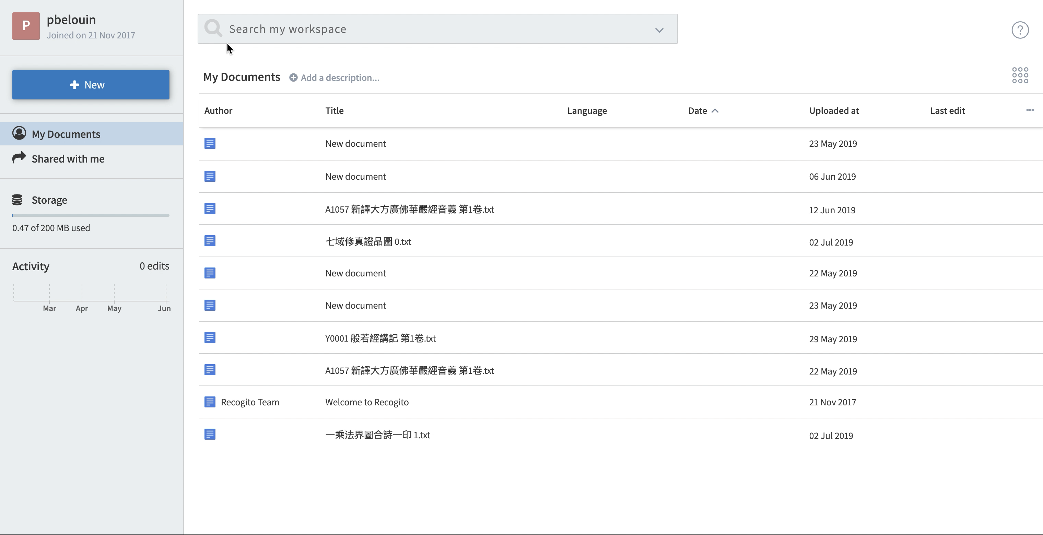
Notes:
Load video here

Slide 11
16 Jun · London · Pascal Belouin & Sean Wang
Please get in touch with comments/questions!
https://rise.mpiwg-berlin.mpg.de/
pbelouin@mpiwg-berlin.mpg.de
Max Planck Institute for the History of Science
(Twitter @MPIWG)
Notes:
ADD THE RISE LOGO HERE SOMEWHERE

Slide 12
Thank you!
tinyurl.com/disrupt2020rise

